Slide 1



Combining the Power of Hadoop with Object-Based Dispersed Storage

Slide 2




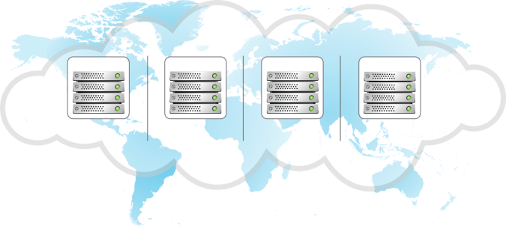
How Cleversafe’s Dispersed Storage Works
DATA
Cleversafe IDA
1
Data is expanded, virtualized, transformed, sliced and dispersed using Information Dispersal Algorithms.
[ Total slices = ‘width’ = N ]
2
Slices are distributed to separate disks, storage nodes and geographic locations.
SITE 1
SITE 2
SITE 3
SITE 4
[ Subset required to read = ‘threshold’ = K ]
3
Real- time bit perfect data is retrieved from a subset of slices.
Cleversafe IDA
DATA
Cleversafe Confidential Information

Slide 3
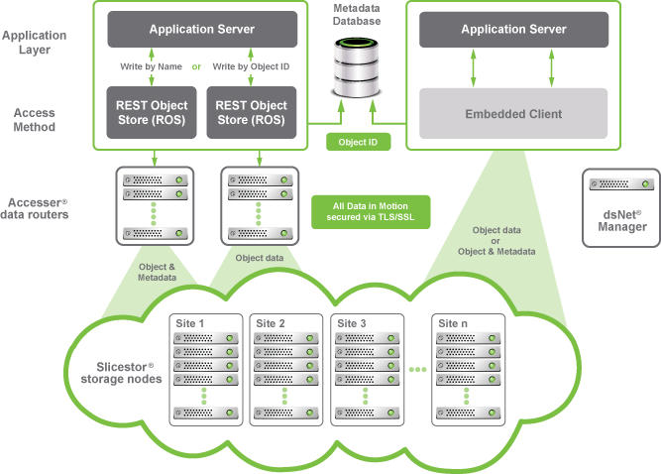
Object-based Access Methods

Slide 4
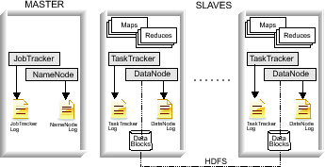
How Hadoop Works
  Popular open-source MapReduce implementation, commercialized by Cloudera and others
Take the computation to the data, not the data to the computation
Compute
Storage
Cleversafe Confidential Information

Slide 5
Hadoop MapReduce Challenges
Master-slave architecture: Namenode
  Point of failure: Previously a single point of failure, now a clustered point of failure with HA
  Scalability bottleneck: In the I/O path. NameNode federation helps, but introduces administrative headaches and increases failure footprint
Efficiency: Replication
  Maintains 3 copies of data for protection – not a big deal in terabyte range – but scale up to petabyte and Exabyte levels and management/overhead costs are unmanageable
Cleversafe Confidential Information

Slide 6


Combining computation and dispersed storage
  Hadoop MapReduce computation runs directly on dsNet Slicestors
  Jobs are assigned to stores for completely local data access
  Replace underlying HDFS with Dispersed Storage® while maintaining HDFS interface to MapReduce process
dsNet Slicestor
dsNet Storage
Hadoop MapReduce
dsNet API
Local data access
Cleversafe Confidential Information

Slide 7







System Architecture
ACCESSERS
MASTER
SLAVES
Job Tracker
Maps
Maps
Reduces
Reduces
Task Tracker
Task Tracker
Job Tracker
Log
Object
Vaults
Metadata
Vaults
Analytic
Vaults
Cleversafe Confidential Information

Slide 8
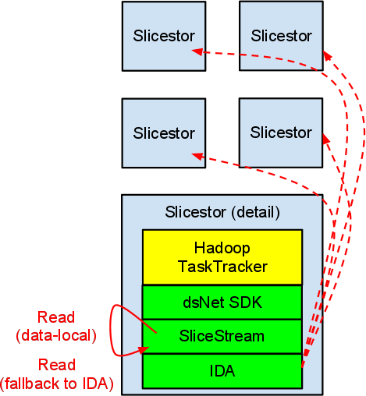
New SliceStream™ Protocol
Concept:
  Manipulate input so that, after dispersal, raw data falls in contiguous chunks
  Read directly from raw slices bypassing IDA reconstruction
    Fall back to full IDA reconstruction if an error occurs
Result:
  Full reliability/availability of dispersal
  On a healthy dsNet, most reads for a MapReduce task can be satisfied locally
Cleversafe Confidential Information

Slide 9
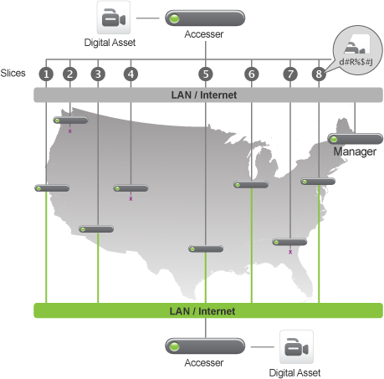
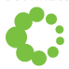
Dispersal Pipeline for Hadoop
Slicestors
Data Projection
Segmentation
IDA
Write cache
Raw data stream
Compute optimized data chunks
Segmentation metadata & 1MB+ segments
Computationally useful slices
Cleversafe Confidential Information

Slide 10
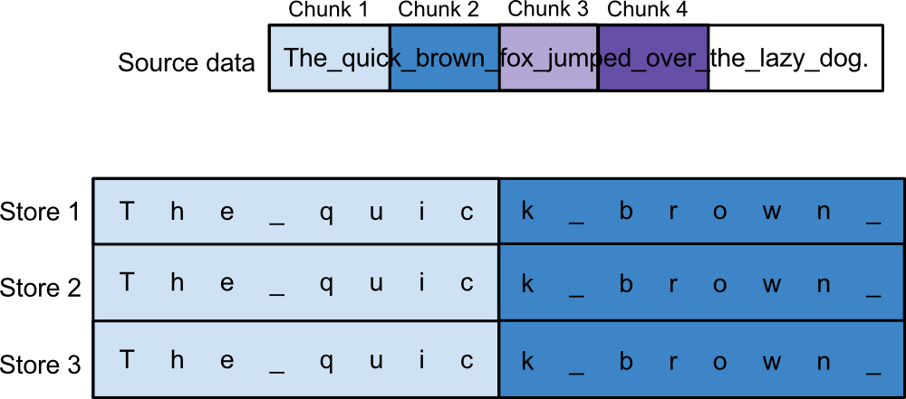
HDFS Data Layout
Dispersed Computing
Chunk 1
Read for Task 1 (64MB)
Chunk 1
Write 1 (64MB * 3x)

Slide 11
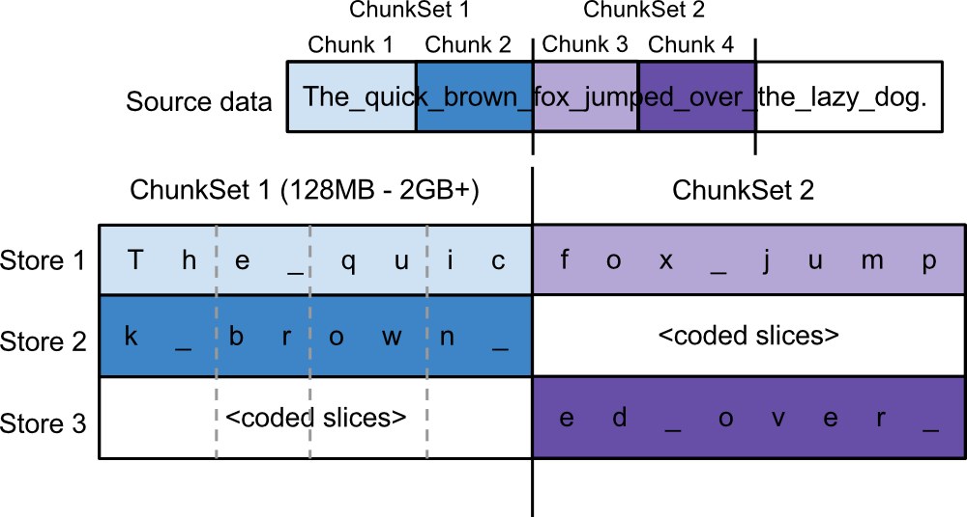
SliceStream™ Data Projection
Dispersed Computing
Chunk 1
Read for Task 1(64MB)
Segment 1
Write 1 (1MB)

Slide 12
Indexing & Hadoop
  One bonus feature: Build & use Object Storage indexes from Hadoop jobs
Build indexes on data using Indexing APIs from MapReduce jobs
Analyze and index data in parallel using index APIs
Search and query your indexed data
Use indexes in MapReduce jobs to efficiently find the data you need to process
Index data and metadata at ingest or later using MapReduce
Query the index directly from MapReduce jobs to find the data you need to analyze
Perform targeted analysis on only the relevant data

Slide 13
Key Features and Benefits
Cost-effective scalability
  Infinite scalability in a single system
Increased performance and productivity
  Computation brought to the data
  dsNet Slicestors provides both computation and storage
  Geographic distribution enabled
Lower storage costs
  Information dispersal calls for one instance of the data vs. 3x with replication
Significantly higher reliability and availability
  Information dispersal eliminates single points of failure
  Continuous data availability with multiple simultaneous device or site failures
Drop in replacement for existing MapReduce jobs via standard Hadoop File System interfaces
Cleversafe Confidential Information

